Slide 1

Customer Personality Analysis
Clustering Problem :
The objective of the analysis is building to perform clustering
to summarize customer segments.
Age | Marital Status | Education | Child | Income | Amount Spent | Total Accepted Campaign | Response

Slide 2



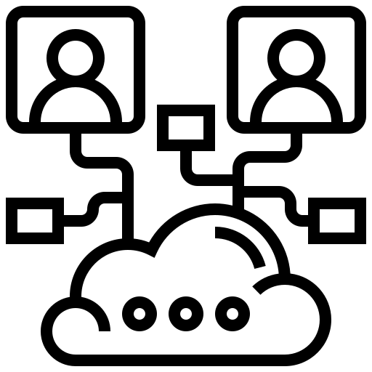

EDA & Visualization
Model Building
Clustering
Deployment

Slide 3
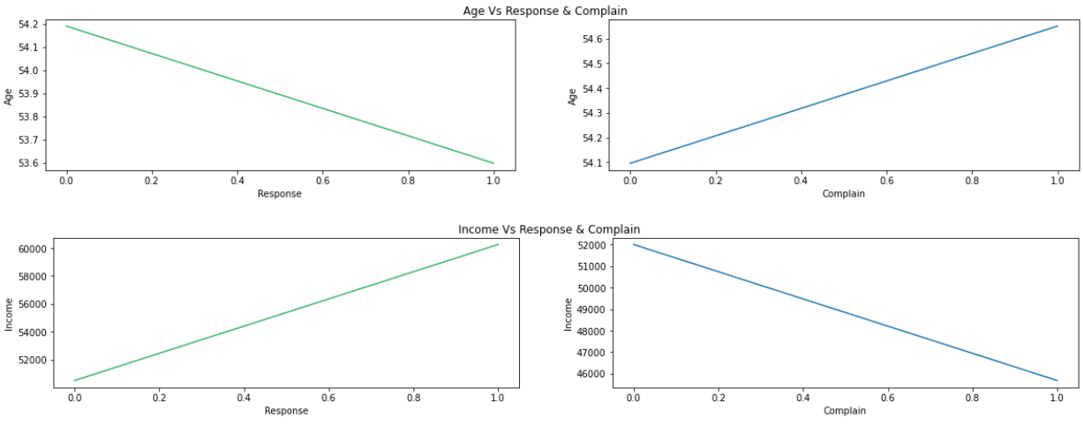

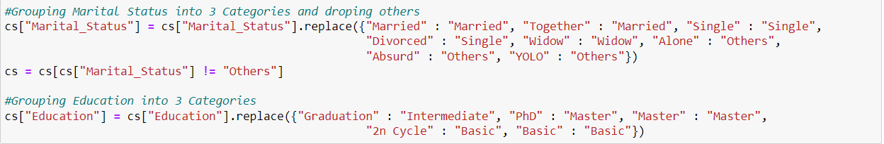
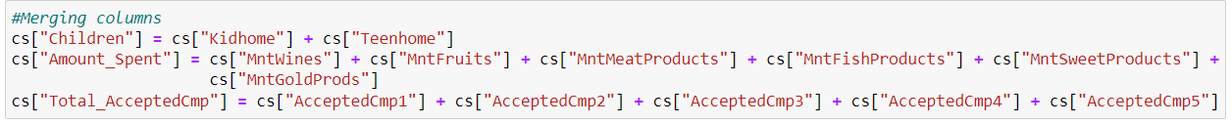
Project analysis slide 10
EDA & Visualization
Created column Age from Birth Year
Classified Marital Status & Education and then One hot Encoded
Removed Outliers by dropping them
Merged columns like Children, Amount Spend & Total_AcceptedCmp
Dropped irrelevant columns
0 == NO RESPONSE NO COMPLAIN In Age Plot the Response Decreases with Age whereas Complain Increases Here with High Income Responses Increases and Complain Decreases

Slide 4


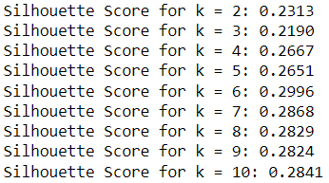
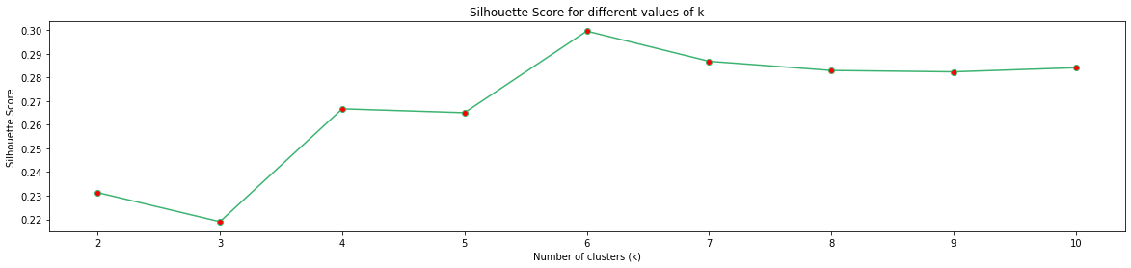
Project analysis slide 10
Clustering
Standardize the data
Applied silhouette score on k means & WCSS (Scree Plot) to find the optimal k
Dropped outliers using DBSCAN

Slide 5



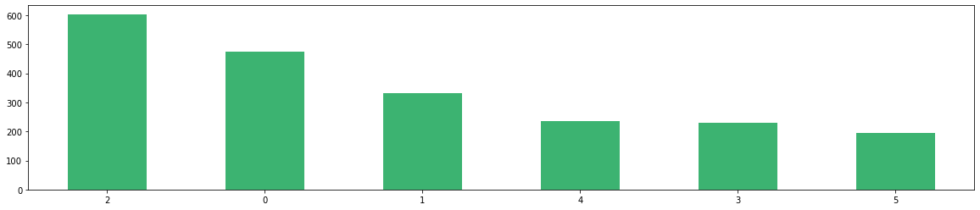
Project analysis slide 11
Model Building
Finalised the model with k = 6 using Kmeans
Cluster Labels Added to the original Data
Dumped the model using pickle

Slide 6
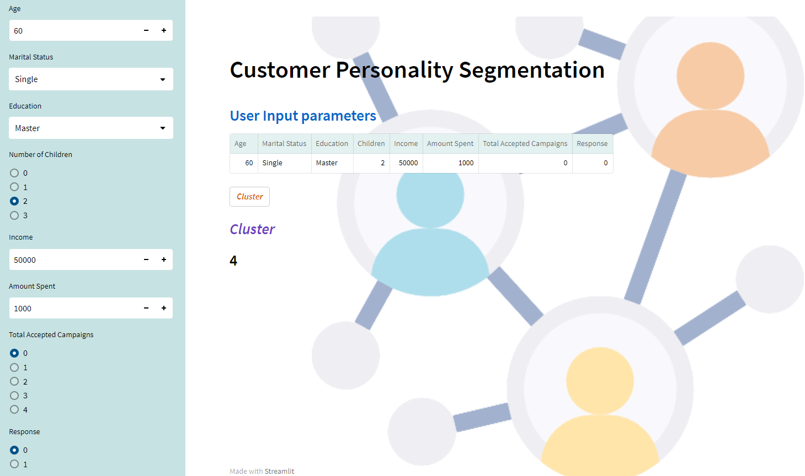
Project analysis slide 11
Deployment
Deployed model on Streamlit using command prompt
Age, Marital Status, Education, Children, Income, Amount Spent, Total_AcceptedCmp & Response as user input
Cluster Button to predict ClusterId

Slide 7

Thank You

